Slide 1
Easwari Engineering College (Autonomous)
Department of Computer Science and Engineering
GESTURE CONTROLLED WHEELCHAIR WITH FALL AND OBSTACLE DETECTION
Supervisor
Dr.R.M.Bhavadharini
Associate Professor/CSE
Student Members
Gadde Amulya (310617104028)
Gopika Sarasvathi K (310617104035)
Kirthiga J (310617104048)
1

Slide 2
Easwari Engineering College (Autonomous) Department of Computer Science and Engineering Objective(s)
To Solve the difficulty in mobility of elderly people using a gesture controlled wheelchair.
To Detect the presence of the user and provide physical assistance incase of accidents.
To Find obstacles and enable the user to navigate independently .

Slide 3
Easwari Engineering College (Autonomous) Department of Computer Science and Engineering Motivation
To allow old aged people to be independent to a certain extent and as well as provide assistance to people who have poor vision or experience difficulties in mobility.
To be effective and economical and largely focused on safety measures thereby it doesn't compromise the safety of the user.
3

Slide 4
Easwari Engineering College (Autonomous) Department of Computer Science and Engineering Literature Survey (1)
AKM Bahalul Haquea,Shawanshurid, AfsanaTasnimJuha, ShadmanSadique, Abu Sayem Mohammad Asaduzzaman, 2020, A Novel Design of Gesture and Voice Controlled Solar-Powered Smart Wheel Chair with Obstacle Detection, IEEE
Techniques/algorithms/Approaches used:
Gesture recognition is done by accelerometer and voice module is built using voice recognition processor which will send the signal to Arduino via Bluetooth. The system is powered by solar power and the obstacle are by detected using ultrasonic sensor.
Achieved Result:
The wheelchair is controlled by voice and gesture, It makes use of solar power. Additionally the Wheelchair can also recognize hindrance.
Issues:
Solar energy must always be present to recharge the chair, while recharging the user can not use the chair.
The cost of the chair is very high due to the installation of solar panels
4

Slide 5
Easwari Engineering College (Autonomous) Department of Computer Science and Engineering Literature Survey (2)
Shayban Nasif, Muhammad Abdul Goffar Khan, 2017, Wireless Head Gesture Controlled Wheel Chair for Disabled Person , IEEE
Techniques/algorithms/Approaches used:
It employs head gesture recognition technique with acceleration sensor. The head gestures that are done by the user are recognized by the acceleration sensor and the wireless controlling is done with the help of radio frequency
Achieved Result
The wheelchair motion for disabled people is controlled using head gestures and wireless connection between the transmitter, fitted on the head (cap) and the receiver makes its use very simple and comfortable
Issues:
Limitation of this work is that, the user may turn their head for glancing or without meaning to change the direction of the wheelchair, that could potentially lead to dangerous situation. There are no means to alert the users on obstacles around them or provide them assistance in times of emergency.
5

Slide 6
Easwari Engineering College (Autonomous) Department of Computer Science and Engineering Literature Survey (3)
MohidM. F. M. Khairudin; L. H. Basirun; R. Jailani, 2020, Motorised Wheelchair with Multicontrol System , IEE Transactions
Techniques/algorithms/Approaches used:
Raspberry Pi is used for the algorithm processing. Development of motorized wheelchair controlled by eye movements and mobile application by the user.
Achieved Result:
Design and implementation of a eye and mobile controlled wheelchair for disabled people
Issues:
Prolong use of eye for the moment of the user might result in strain to the eye .
The user might unknowingly move their eye resulting in the movement of the wheelchair too which might be harmful for user.
6

Slide 7
Easwari Engineering College (Autonomous) Department of Computer Science and Engineering Issues in the Existing Systems
In existing system, there is no combination of obstacle and fall detection with gesture controlled system.
With the help of an obstacle sensor and fall detection system, an extra layer of security is provided for the user. It will prevent the user from running into people/objects as well detect the presence of the user on the wheelchair and alert a family member or hospital in case of an emergency.
7

Slide 8
Easwari Engineering College (Autonomous) Department of Computer Science and Engineering Proposed System
Controlling Wheelchair with Simple Hand gestures
Facilitates fall detection alert in case of accidents.
Obstacle sensor to alert the user in case of any hurdles.
8

Slide 9
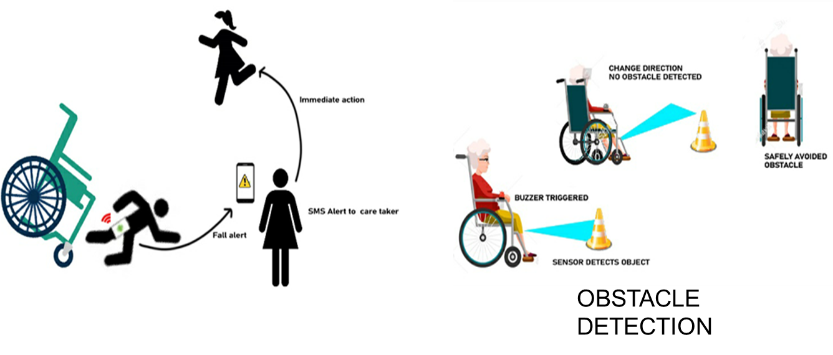
Easwari Engineering College (Autonomous) Department of Computer Science and Engineering System Architecture
FALL DETECTION

Slide 10
Easwari Engineering College (Autonomous) Department of Computer Science and Engineering System Architecture
Diagram of Gesture Recognition System
INPUTS OUTPUT
ARDUINO
UNO
GESTURE FROM THE USER(left ,right,up,down)
3-AXIS
ACCELEROMETER
DC MOTOR
Detects gestures
1-Jul-21
10
10
10

Slide 11
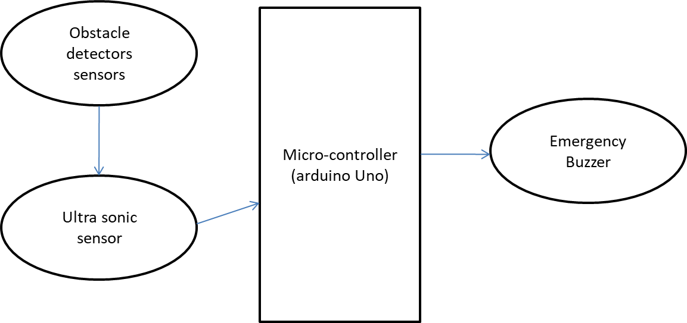
System Architecture
Easwari Engineering College (Autonomous) Department of Computer Science and Engineering
Architectural Diagram of Obstacle detection system
INPUT OUTPUT
11

Slide 12
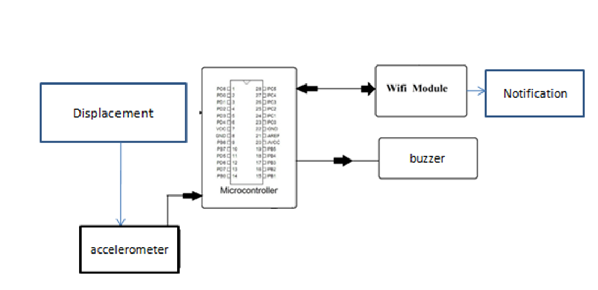
Easwari Engineering College (Autonomous) Department of Computer Science and Engineering System Architecture
Architectural Diagram of Fall detection system

Slide 13
Easwari Engineering College (Autonomous) Department of Computer Science and Engineering Functional Architecture
Gesture Control
Hand Gestures
Detected
Transmitted to Arduino
The Motors move the wheels
The wheel chair is moved using Gestures
Wheelchair
Fall Detector
Displacement is detected
Notification is sent to Caretakers Mobile
Obstacle Detector
Any Obstacle is detected in the path
Transmitted to Arduino
Buzzer is triggered

Slide 14
Easwari Engineering College (Autonomous) Department of Computer Science and Engineering List of Modules
Gesture
Obstacle detection
Fall detection

Slide 15
Easwari Engineering College (Autonomous) Department of Computer Science and Engineering System Requirements
The proposed system is mainly developed to alleviate the problems faced by
elderly people , and enable them to move independently with help of gesture
controlled wheelchair, as well as detection of obstacles and ensure the safety
of the user with fall detection This system makes use of the following:
The programming is done in Arduino Sketch software.
Input from user for Fall detection is received through Node MCU.
Inputs from user for hand gesture and obstacle detection is received through Arduino UNO.
Accelerometer is used for reading both hand gestures and presence of user on the wheelchair.
Ultrasonic Sensor is used for obstacle detection .
15

Slide 16
Easwari Engineering College (Autonomous) Department of Computer Science and Engineering Input and Output of the System
Input data
Hand signals from the user to navigate the wheelchair.
Reflected ultrasonic waves from the object to detect objects.
Change in orientation of the user
Expected output of the System-
Wheelchair to move as per the hand gestures of the user , warn the user by triggering alarm if any obstacles in the path and also warn the caretaker through SMS if fall detected.

Slide 17
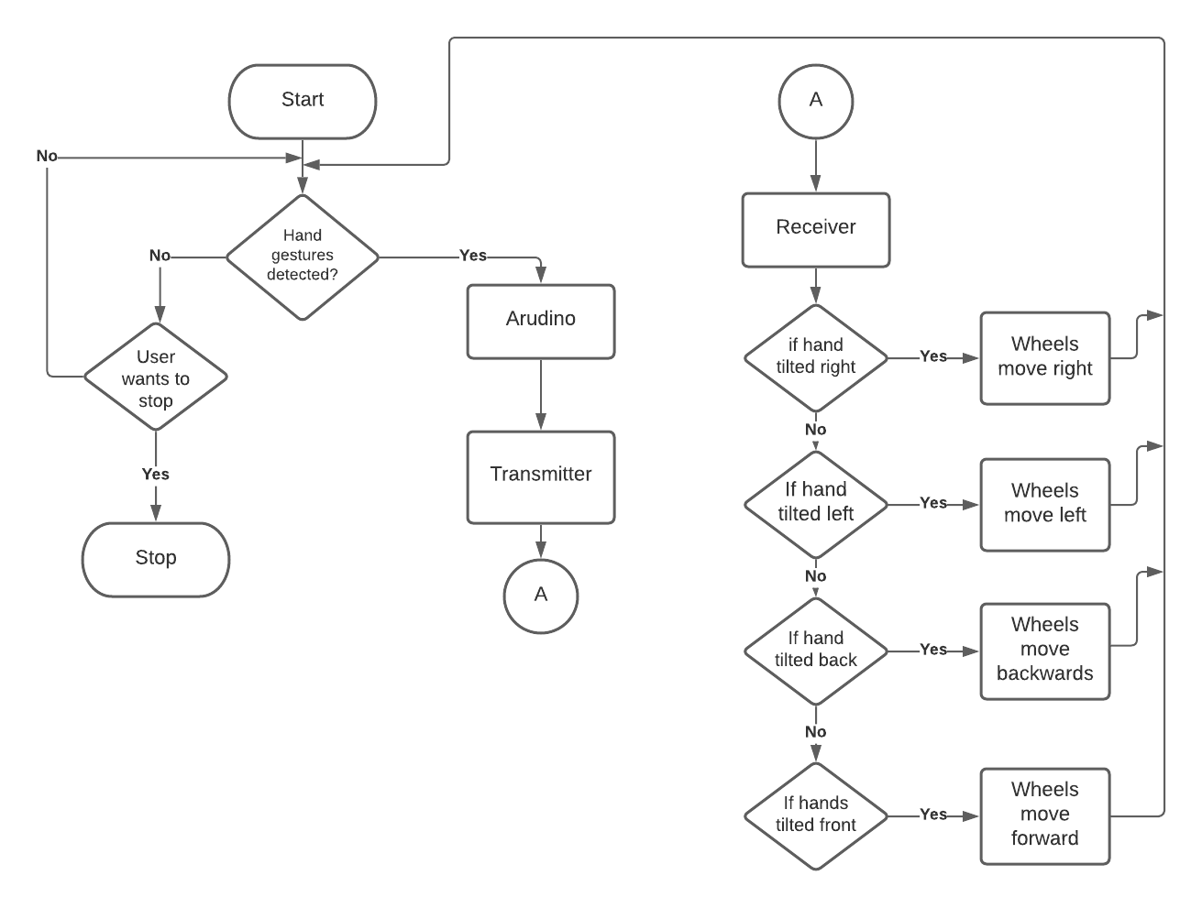
Easwari Engineering College (Autonomous) Department of Computer Science and Engineering Module 1 ( Gesture control )
(INPUT)
(INPUT)
(OUTPUT)

Slide 18
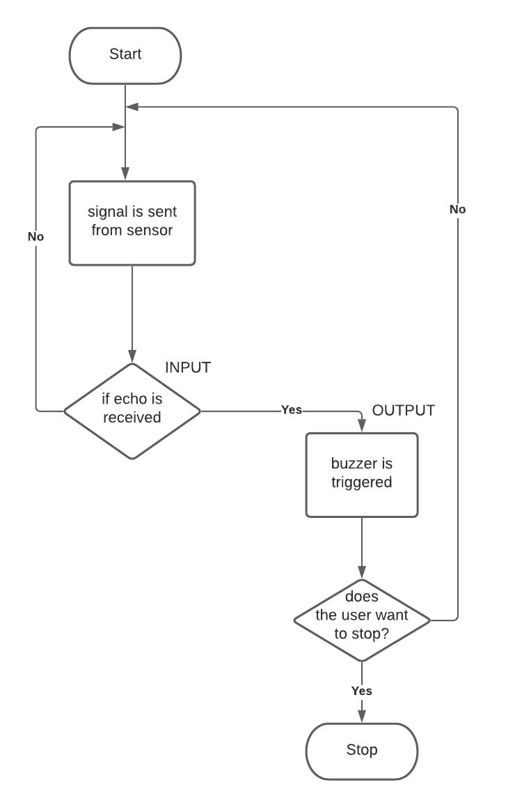
Easwari Engineering College (Autonomous) Department of Computer Science and Engineering Module 2 ( Obstacle Detection)

Slide 19
Easwari Engineering College (Autonomous) Department of Computer Science and Engineering Module 3 (Fall Detection)
Start
Any displacement Input
A
Accelerometer detects the displacement
Notification is displayed on phone
Sends to Node MCU
Stop
Sends notification
A

Slide 20
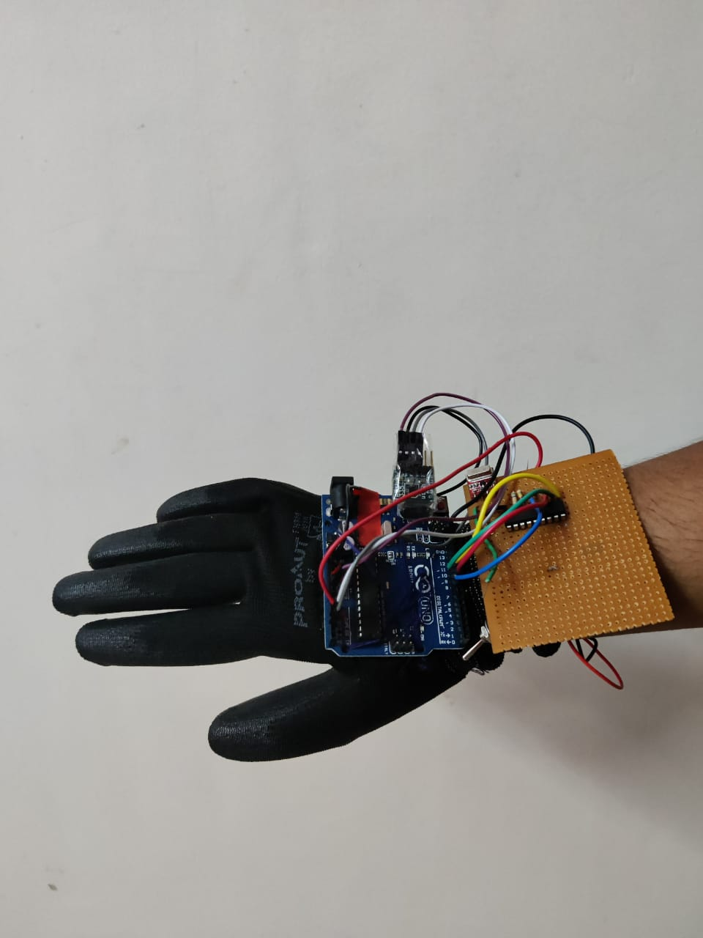
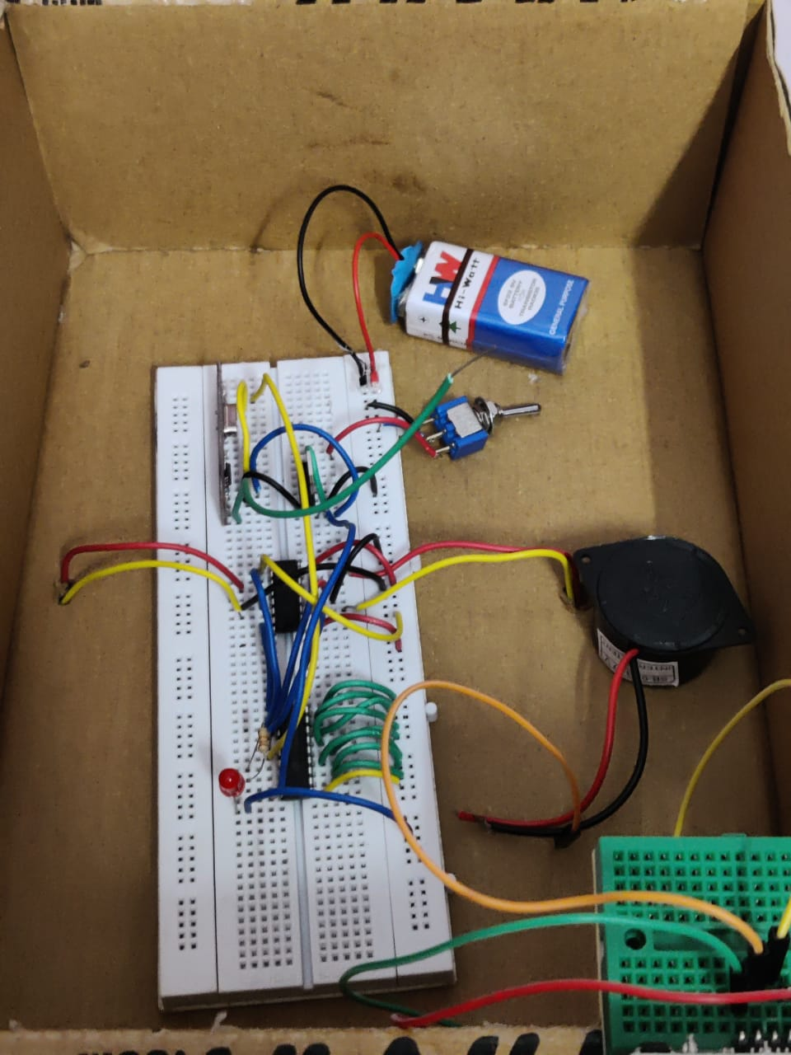
Easwari Engineering College (Autonomous) Department of Computer Science and Engineering Snapshots of the Results
Transmitter
Receiver

Slide 21
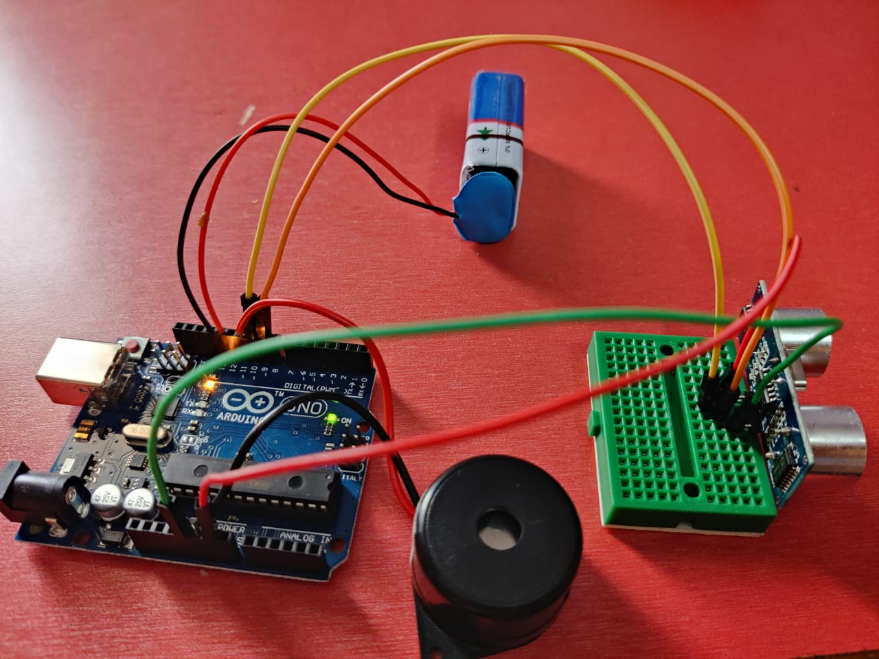
Easwari Engineering College (Autonomous) Department of Computer Science and Engineering Snapshots of the Results

Slide 22
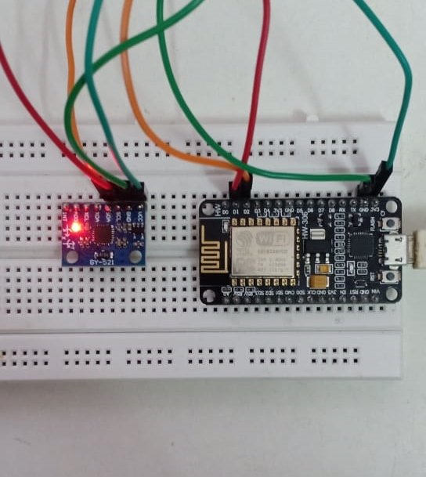
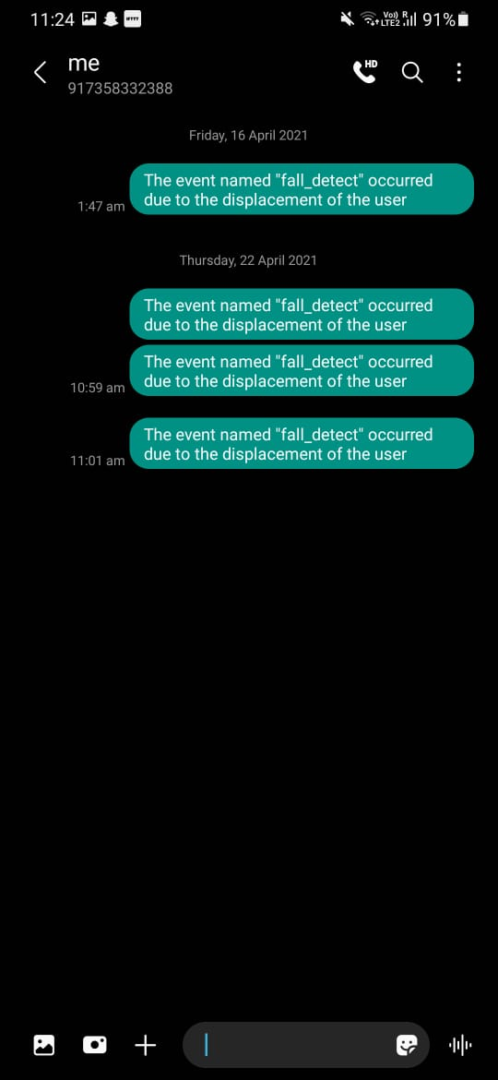
Easwari Engineering College (Autonomous) Department of Computer Science and Engineering Snapshots of the Results

Slide 23
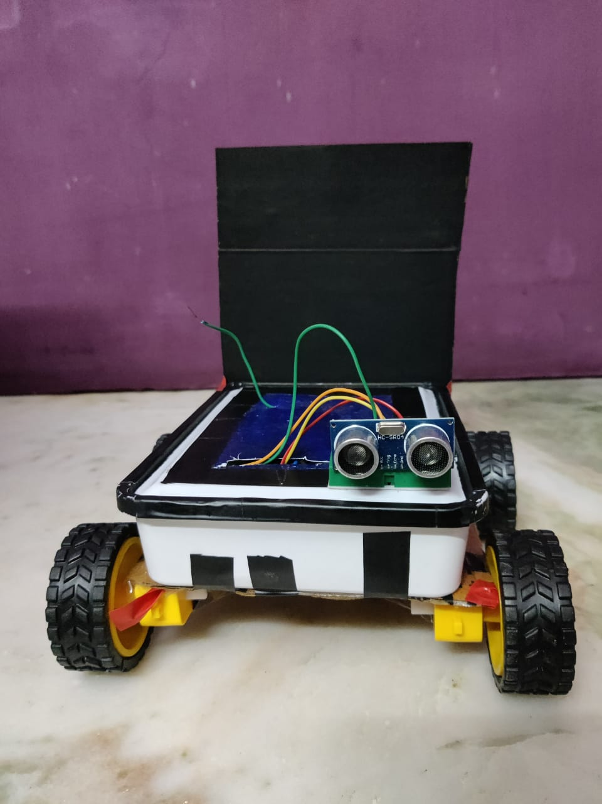
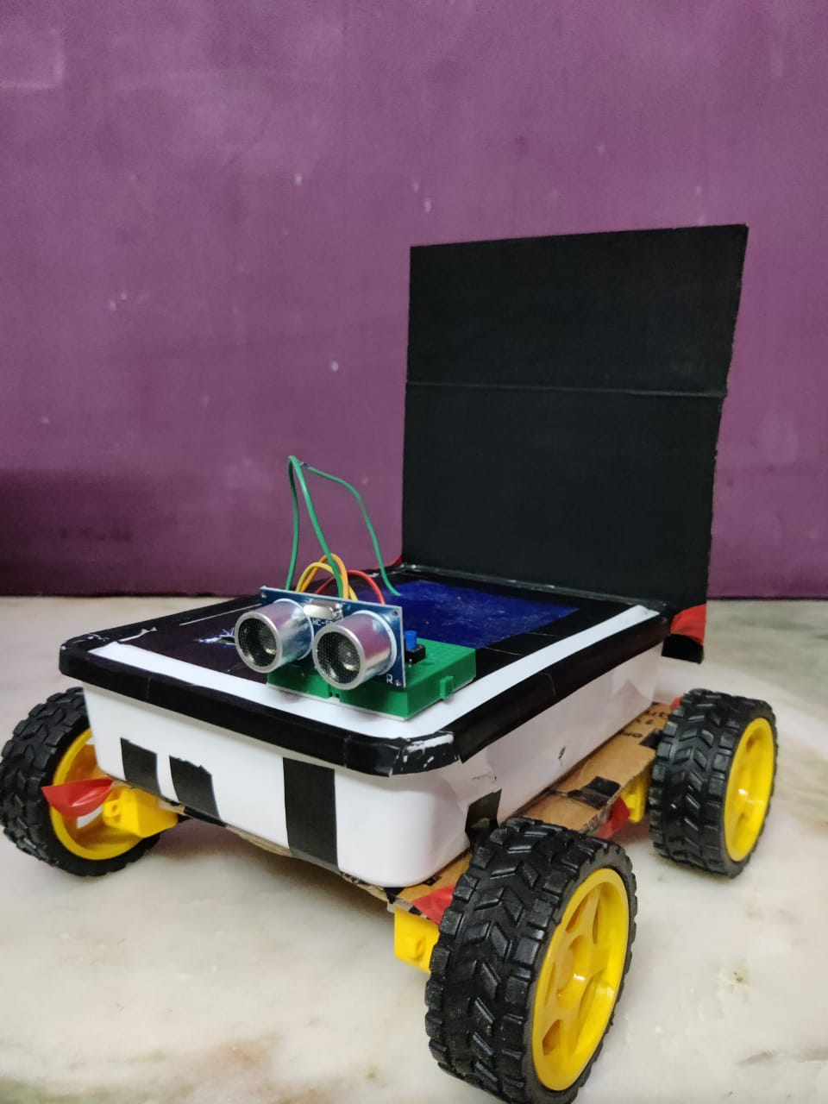
Easwari Engineering College (Autonomous) Department of Computer Science and Engineering Snapshots of the Results

Slide 24
Easwari Engineering College (Autonomous) Department of Computer Science and Engineering Performance Analysis
Gesture module, hand has to be tilted approx 120° to the direction to move except for left and backward, where the angle is approx 60° and 70° respectfully . At rest, the system stops.
Obstacle Detection – the range of the sensor lies between 2cm to 400cm and can be extended or shortened according to the preference. Our system can detect obstacles within 20cm.
Fall Detection - 2050, 77, 1947 are values for calibration of an accelerometer. They can be changed accordingly

Slide 25
Easwari Engineering College (Autonomous) Department of Computer Science and Engineering Applications
The wheelchair can be used to assist elderly people in their daily lives.
This chair can also help the disabled and elderly with poor vision by avoiding obstacles and allowing them to move independently to a certain extent.

Slide 26
Easwari Engineering College (Autonomous) Department of Computer Science and Engineering Conclusion and Future Work
Thus ,the gesture controlled wheelchair with obstacle and fall detection can aid the senior citizens in their daily life, providing them independency to move around and the support to be independent , giving them the strength of being able to support themselves. Also, giving assurance to the concerned caretaker, the safety of the user.
Limitation of this system would be not be able to provide elderly people other disability such as hand immobility. This can be overcome by introducing brainwave controlled wheelchair, where according to the attention level of the user, the wheelchair can be moved. In such way, the system can be improved to aid the elderly to lead a comfortable lifestyle.

Slide 27
Easwari Engineering College (Autonomous) Department of Computer Science and Engineering References
Asaduzzaman ,Afsana Tasnim Juha (2020). “A Novel Design of Gesture and Voice Controlled Solar-Powered Smart Wheel Chair with Obstacle Detection”, IEEE International Conference on Informatics, IoT, and Enabling Technologies (ICIoT), IEEE Xplore
ShaybanNasif, Muhammad Abdul Goffar Khan (2017). "Wireless Head Gesture Controlled Wheel Chair for Disabled Persons ", Proceedings of the 2017 IEEE Region 10 Humanitarian Technology Conference (R10-HTC) IEEE Xplore
Mohid M. F. M. Khairudin; L. H. Basirun; R. Jailani (2020), “Motorised Wheelchair with Multicontrol System”, IEEE 10th Symposium on Computer Applications & Industrial Electronics (ISCAIE)IEEE Transactions
27

Slide 28
Easwari Engineering College (Autonomous) Department of Computer Science and Engineering Publication
Conference
1. Presented the paper titled “ Survey on gesture
controlled wheelchair with fall and obstacle sensor ”in 2nd International e-Conference on Information, Communication and Networking 2021 eICICN 21, Department of IT, Easwari Engineering College on 10th April, 2021
2. Presented the paper titled “Gesture Controlled Wheelchair with Fall and Obstacle Detection” in 2nd International e-Conference on Information, Communication and Networking 2021 eICICN 21, Department of IT, Easwari Engineering College on 10th April, 2021.
Journal
1. Processed the paper titled “ Gesture controlled wheelchair with fall and obstacle sensor ” in Recent Advances in Computer Science and Communication on 30th June, 2021

Slide 29
Thank You
29

